Slide 1
Chapter 3 Stacks and Queues

Slide 2
Outline
Implementation stack by array
Implementation queue by array
A Mazing Problem
Infix to postfix

Slide 3
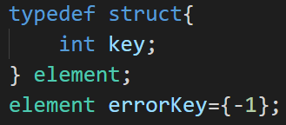
Implementation stack by array
用array實作出stack的新增和刪除功能
建立結構 element
主要四個function
插入: push
刪除: pop
Stack已滿: stackFull
Stack為空: stackEmpty

Slide 4
Implementation stack by array
插入: push
依序插入 10, 25, 14
初始狀態
位置
-1
0
1
2
3
Stack
top

Slide 5
Implementation stack by array
插入: push
依序插入 10, 25, 14
top+1
位置
-1
0
1
2
3
Stack
top

Slide 6
Implementation stack by array
插入: push
依序插入 10, 25, 14
插入10
位置
-1
0
1
2
3
Stack
10
top

Slide 7
Implementation stack by array
插入: push
依序插入 10, 25, 14
top+1
位置
-1
0
1
2
3
Stack
10
top

Slide 8
Implementation stack by array
插入: push
依序插入 10, 25, 14
插入25
位置
-1
0
1
2
3
Stack
10
25
top

Slide 9
Implementation stack by array
插入: push
依序插入 10, 25, 14
top+1
位置
-1
0
1
2
3
Stack
10
25
top

Slide 10
Implementation stack by array
插入: push
依序插入 10, 25, 14
插入14
位置
-1
0
1
2
3
Stack
10
25
14
top

Slide 11
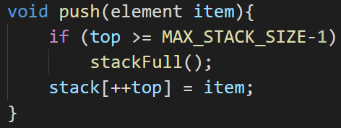
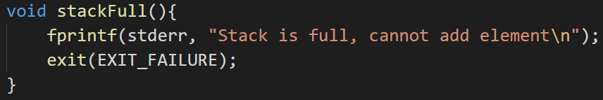
Implementation stack by array
插入: push
Stack已滿: stackFull
超出array大小時無法插入資料
將top移到要插入資料的位置
並插入資料

Slide 12
Implementation stack by array
刪除: pop
刪除順序依照”後進先出”
目前stack
位置
-1
0
1
2
3
Stack
10
25
14
top

Slide 13
Implementation stack by array
刪除: pop
刪除順序依照”後進先出”
刪除14
位置
-1
0
1
2
3
Stack
10
25
top

Slide 14
Implementation stack by array
刪除: pop
刪除順序依照”後進先出”
top-1
位置
-1
0
1
2
3
Stack
10
25
top

Slide 15
Implementation stack by array
刪除: pop
刪除順序依照”後進先出”
刪除25
位置
-1
0
1
2
3
Stack
10
top

Slide 16
Implementation stack by array
刪除: pop
刪除順序依照”後進先出”
top-1
位置
-1
0
1
2
3
Stack
10
top

Slide 17
Implementation stack by array
刪除: pop
刪除順序依照”後進先出”
刪除10
位置
-1
0
1
2
3
Stack
top

Slide 18
Implementation stack by array
刪除: pop
刪除順序依照”後進先出”
top-1
位置
-1
0
1
2
3
Stack
top

Slide 19
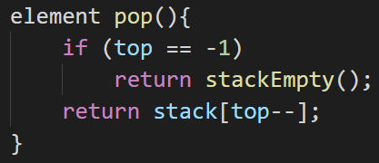
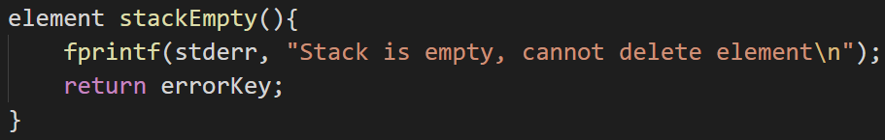
Implementation stack by array
刪除: pop
Stack為空: stackEmpty
array是空的則無法刪除資料
指到的資料後回傳

Slide 20
Implementation queue by array
用array實作出queue的新增和刪除功能
建立結構 element
主要四個function
插入: addq
刪除: deleteq
Queue已滿: queueFull
Queue為空: queueEmpty

Slide 21
Implementation queue by array
插入: addq
依序插入 10, 25, 14
初始狀態
位置
-1
0
1
2
3
Queue
front
rear

Slide 22
Implementation queue by array
插入: addq
依序插入 10, 25, 14
rear+1
位置
-1
0
1
2
3
Queue
front
rear

Slide 23
Implementation queue by array
插入: addq
依序插入 10, 25, 14
插入10
位置
-1
0
1
2
3
Queue
10
front
rear

Slide 24
Implementation queue by array
插入: addq
依序插入 10, 25, 14
rear+1
位置
-1
0
1
2
3
Queue
10
front
rear

Slide 25
Implementation queue by array
插入: addq
依序插入 10, 25, 14
插入25
位置
-1
0
1
2
3
Queue
10
25
front
rear

Slide 26
Implementation queue by array
插入: addq
依序插入 10, 25, 14
rear+1
位置
-1
0
1
2
3
Queue
10
25
front
rear

Slide 27
Implementation queue by array
插入: addq
依序插入 10, 25, 14
插入14
位置
-1
0
1
2
3
Queue
10
25
14
front
rear

Slide 28
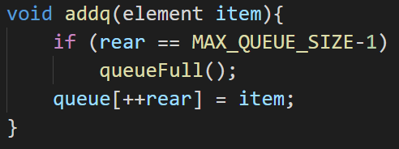
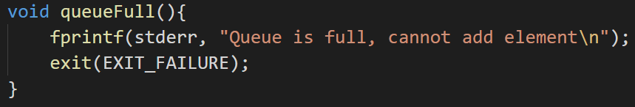
Implementation queue by array
插入: addq
Queue已滿: queueFull
array是滿的則無法插入資料
將rear移到要增加資料的位置並插入資料

Slide 29
Implementation queue by array
刪除: deleteq
刪除順序依照”先進先出”
目前queue
位置
-1
0
1
2
3
Queue
10
25
14
front
rear

Slide 30
Implementation queue by array
刪除: deleteq
刪除順序依照”先進先出”
front+1
位置
-1
0
1
2
3
Queue
10
25
14
front
rear

Slide 31
Implementation queue by array
刪除: deleteq
刪除順序依照”先進先出”
刪除10
位置
-1
0
1
2
3
Queue
25
14
front
rear

Slide 32
Implementation queue by array
刪除: deleteq
刪除順序依照”先進先出”
front+1
位置
-1
0
1
2
3
Queue
25
14
front
rear

Slide 33
Implementation queue by array
刪除: deleteq
刪除順序依照”先進先出”
刪除25
位置
-1
0
1
2
3
Queue
14
front
rear

Slide 34
Implementation queue by array
刪除: deleteq
刪除順序依照”先進先出”
front+1
位置
-1
0
1
2
3
Queue
14
rear
front

Slide 35
Implementation queue by array
刪除: deleteq
刪除順序依照”先進先出”
刪除14
位置
-1
0
1
2
3
Queue
rear
front

Slide 36
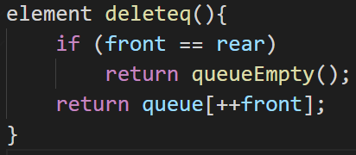
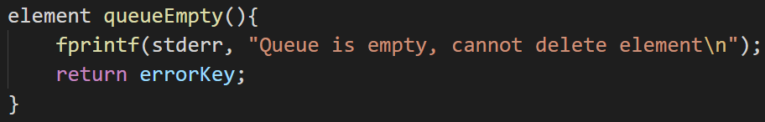
Implementation queue by array
刪除: deleteq
Queue為空: queueEmpty
array是空的則無法刪除資料
將front往要刪除的資料方向移動並刪除資料

Slide 37
A Mazing Problem
設計一個地圖，用stack記錄從起點走到終點的路徑
實行步驟:
initMap()
初始地圖map[][]
初始標記mark[][]
初始方位(八方位)
path()
起點
1 | 1 | 1 | 1 | 1 | 1
1 | 0 | 0 | 1 | 0 | 1
1 | 0 | 0 | 0 | 1 | 1
1 | 0 | 1 | 1 | 1 | 1
1 | 0 | 0 | 0 | 0 | 1
1 | 1 | 1 | 1 | 1 | 1
map[6][6]
終點

Slide 38
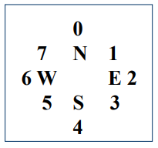
A Mazing Problem
init
0是路(可以走的)，1是牆(不能走的)
1 | 1 | 1 | 1 | 1 | 1
1 | 0 | 0 | 1 | 0 | 1
1 | 0 | 0 | 0 | 1 | 1
1 | 0 | 1 | 1 | 1 | 1
1 | 0 | 0 | 0 | 0 | 1
1 | 1 | 1 | 1 | 1 | 1
1 | 1 | 1 | 1 | 1 | 1
1 | 0 | 0 | 0 | 0 | 1
1 | 0 | 0 | 0 | 0 | 1
1 | 0 | 0 | 0 | 0 | 1
1 | 0 | 0 | 0 | 0 | 1
1 | 1 | 1 | 1 | 1 | 1
map[6][6]
mark[6][6]
八方位

Slide 39
A Mazing Problem
第一步
從起點(1, 1)開始，mark標記已走過，直到方向2有路且沒有走過
1 | 1 | 1 | 1 | 1 | 1
1 | 1 | 0 | 1 | 0 | 1
1 | 0 | 0 | 0 | 1 | 1
1 | 0 | 1 | 1 | 1 | 1
1 | 0 | 0 | 0 | 0 | 1
1 | 1 | 1 | 1 | 1 | 1
1 | 1 | 1 | 1 | 1 | 1
1 | 1 | 0 | 0 | 0 | 1
1 | 0 | 0 | 0 | 0 | 1
1 | 0 | 0 | 0 | 0 | 1
1 | 0 | 0 | 0 | 0 | 1
1 | 1 | 1 | 1 | 1 | 1
map[6][6]
mark[6][6]
八方位

Slide 40
A Mazing Problem
第二步
走向(1, 2)，mark標記已走過，直到方向3有路且沒有走過
1 | 1 | 1 | 1 | 1 | 1
1 | 1 | 1 | 1 | 0 | 1
1 | 0 | 0 | 0 | 1 | 1
1 | 0 | 1 | 1 | 1 | 1
1 | 0 | 0 | 0 | 0 | 1
1 | 1 | 1 | 1 | 1 | 1
1 | 1 | 1 | 1 | 1 | 1
1 | 1 | 1 | 0 | 0 | 1
1 | 0 | 0 | 0 | 0 | 1
1 | 0 | 0 | 0 | 0 | 1
1 | 0 | 0 | 0 | 0 | 1
1 | 1 | 1 | 1 | 1 | 1
map[6][6]
mark[6][6]
八方位

Slide 41
A Mazing Problem
第三步
走向(2, 3)，mark標記已走過，直到方向1有路且沒有走過
1 | 1 | 1 | 1 | 1 | 1
1 | 1 | 1 | 1 | 0 | 1
1 | 0 | 0 | 1 | 1 | 1
1 | 0 | 1 | 1 | 1 | 1
1 | 0 | 0 | 0 | 0 | 1
1 | 1 | 1 | 1 | 1 | 1
1 | 1 | 1 | 1 | 1 | 1
1 | 1 | 1 | 0 | 0 | 1
1 | 0 | 0 | 1 | 0 | 1
1 | 0 | 0 | 0 | 0 | 1
1 | 0 | 0 | 0 | 0 | 1
1 | 1 | 1 | 1 | 1 | 1
map[6][6]
mark[6][6]
八方位

Slide 42
A Mazing Problem
第四步
走向(1, 4)，mark標記已走過，所有方向都沒路，退回上一步
1 | 1 | 1 | 1 | 1 | 1
1 | 1 | 1 | 1 | 0 | 1
1 | 0 | 0 | 1 | 1 | 1
1 | 0 | 1 | 1 | 1 | 1
1 | 0 | 0 | 0 | 0 | 1
1 | 1 | 1 | 1 | 1 | 1
1 | 1 | 1 | 1 | 1 | 1
1 | 1 | 1 | 0 | 1 | 1
1 | 0 | 0 | 1 | 0 | 1
1 | 0 | 0 | 0 | 0 | 1
1 | 0 | 0 | 0 | 0 | 1
1 | 1 | 1 | 1 | 1 | 1
map[6][6]
mark[6][6]
八方位

Slide 43
A Mazing Problem
第5步
走向(2, 3)，從方向2開始繼續找路，直到方向6有路且沒有走過
1 | 1 | 1 | 1 | 1 | 1
1 | 1 | 1 | 1 | 0 | 1
1 | 0 | 0 | 1 | 1 | 1
1 | 0 | 1 | 1 | 1 | 1
1 | 0 | 0 | 0 | 0 | 1
1 | 1 | 1 | 1 | 1 | 1
1 | 1 | 1 | 1 | 1 | 1
1 | 1 | 1 | 0 | 1 | 1
1 | 0 | 0 | 1 | 0 | 1
1 | 0 | 0 | 0 | 0 | 1
1 | 0 | 0 | 0 | 0 | 1
1 | 1 | 1 | 1 | 1 | 1
map[6][6]
mark[6][6]
八方位

Slide 44
A Mazing Problem
第6步
走向(2, 2)，mark標記已走過，直到方向5有路且沒有走過
1 | 1 | 1 | 1 | 1 | 1
1 | 1 | 1 | 1 | 0 | 1
1 | 0 | 1 | 1 | 1 | 1
1 | 0 | 1 | 1 | 1 | 1
1 | 0 | 0 | 0 | 0 | 1
1 | 1 | 1 | 1 | 1 | 1
1 | 1 | 1 | 1 | 1 | 1
1 | 1 | 1 | 0 | 1 | 1
1 | 0 | 1 | 1 | 0 | 1
1 | 0 | 0 | 0 | 0 | 1
1 | 0 | 0 | 0 | 0 | 1
1 | 1 | 1 | 1 | 1 | 1
map[6][6]
mark[6][6]
八方位

Slide 45
A Mazing Problem
以此類推
1 | 1 | 1 | 1 | 1 | 1
1 | 1 | 1 | 1 | 0 | 1
1 | 0 | 1 | 1 | 1 | 1
1 | 1 | 1 | 1 | 1 | 1
1 | 0 | 0 | 0 | 0 | 1
1 | 1 | 1 | 1 | 1 | 1
1 | 1 | 1 | 1 | 1 | 1
1 | 1 | 1 | 0 | 1 | 1
1 | 0 | 1 | 1 | 0 | 1
1 | 1 | 0 | 0 | 0 | 1
1 | 0 | 0 | 0 | 0 | 1
1 | 1 | 1 | 1 | 1 | 1
map[6][6]
mark[6][6]
八方位

Slide 46
A Mazing Problem
以此類推
1 | 1 | 1 | 1 | 1 | 1
1 | 1 | 1 | 1 | 0 | 1
1 | 0 | 1 | 1 | 1 | 1
1 | 1 | 1 | 1 | 1 | 1
1 | 0 | 0 | 0 | 0 | 1
1 | 1 | 1 | 1 | 1 | 1
1 | 1 | 1 | 1 | 1 | 1
1 | 1 | 1 | 0 | 1 | 1
1 | 1 | 1 | 1 | 0 | 1
1 | 1 | 0 | 0 | 0 | 1
1 | 0 | 0 | 0 | 0 | 1
1 | 1 | 1 | 1 | 1 | 1
map[6][6]
mark[6][6]
八方位

Slide 47
A Mazing Problem
以此類推
1 | 1 | 1 | 1 | 1 | 1
1 | 1 | 1 | 1 | 0 | 1
1 | 0 | 1 | 1 | 1 | 1
1 | 1 | 1 | 1 | 1 | 1
1 | 0 | 0 | 0 | 0 | 1
1 | 1 | 1 | 1 | 1 | 1
1 | 1 | 1 | 1 | 1 | 1
1 | 1 | 1 | 0 | 1 | 1
1 | 1 | 1 | 1 | 0 | 1
1 | 1 | 0 | 0 | 0 | 1
1 | 0 | 0 | 0 | 0 | 1
1 | 1 | 1 | 1 | 1 | 1
map[6][6]
mark[6][6]
八方位

Slide 48
A Mazing Problem
以此類推
1 | 1 | 1 | 1 | 1 | 1
1 | 1 | 1 | 1 | 0 | 1
1 | 0 | 1 | 1 | 1 | 1
1 | 1 | 1 | 1 | 1 | 1
1 | 0 | 1 | 0 | 0 | 1
1 | 1 | 1 | 1 | 1 | 1
1 | 1 | 1 | 1 | 1 | 1
1 | 1 | 1 | 0 | 1 | 1
1 | 1 | 1 | 1 | 0 | 1
1 | 1 | 0 | 0 | 0 | 1
1 | 0 | 1 | 0 | 0 | 1
1 | 1 | 1 | 1 | 1 | 1
map[6][6]
mark[6][6]
八方位

Slide 49
A Mazing Problem
以此類推
1 | 1 | 1 | 1 | 1 | 1
1 | 1 | 1 | 1 | 0 | 1
1 | 0 | 1 | 1 | 1 | 1
1 | 1 | 1 | 1 | 1 | 1
1 | 0 | 1 | 1 | 0 | 1
1 | 1 | 1 | 1 | 1 | 1
1 | 1 | 1 | 1 | 1 | 1
1 | 1 | 1 | 0 | 1 | 1
1 | 1 | 1 | 1 | 0 | 1
1 | 1 | 0 | 0 | 0 | 1
1 | 0 | 1 | 1 | 0 | 1
1 | 1 | 1 | 1 | 1 | 1
map[6][6]
mark[6][6]
八方位

Slide 50
A Mazing Problem
以此類推，最後走到終點
1 | 1 | 1 | 1 | 1 | 1
1 | 1 | 1 | 1 | 0 | 1
1 | 0 | 1 | 1 | 1 | 1
1 | 1 | 1 | 1 | 1 | 1
1 | 0 | 1 | 1 | 1 | 1
1 | 1 | 1 | 1 | 1 | 1
1 | 1 | 1 | 1 | 1 | 1
1 | 1 | 1 | 0 | 1 | 1
1 | 1 | 1 | 1 | 0 | 1
1 | 1 | 0 | 0 | 0 | 1
1 | 0 | 1 | 1 | 1 | 1
1 | 1 | 1 | 1 | 1 | 1
map[6][6]
mark[6][6]
八方位

Slide 51
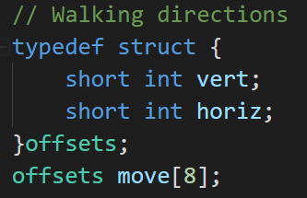
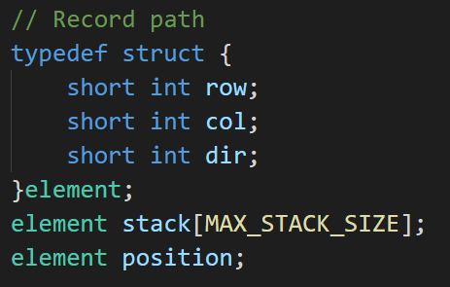
A Mazing Problem
建立struct

Slide 52
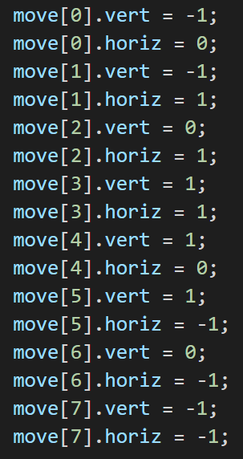
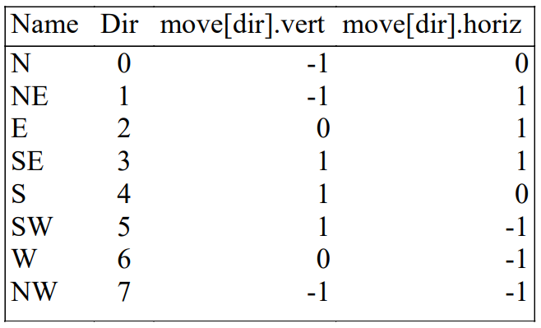
A Mazing Problem
方向

Slide 53
A Mazing Problem
方向

Slide 54
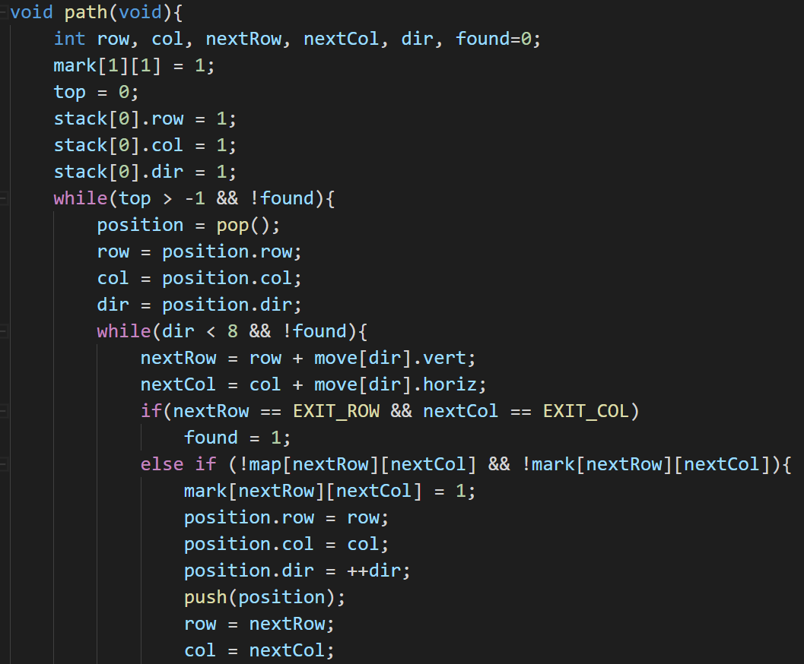
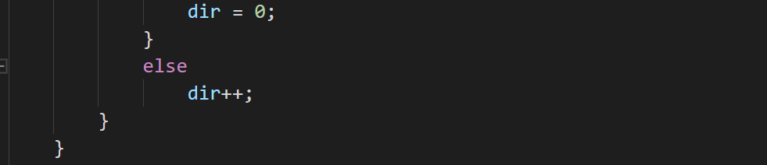
A Mazing Problem
// 重複執行直到到達終點前
// 從方向0開始依序找路
// 走到出口
// 有路可走(map有路且mark沒走過)
// 放入stack，紀錄路徑

Slide 55
Infix to postfix
輸入infix，輸出postfix
主要二個function
token to string: getToken()
infix to postfix: postfix()

Slide 56
Infix to postfix
input: a*(b+c)*d
token
output
a
*
(
b
+
c
)
*
d
a
b
c
+
*
d
*
+
top = 2
(
top = 1
*
top = 0
stack
top = -1
Notes:
P135 Figure 3.16

Slide 57
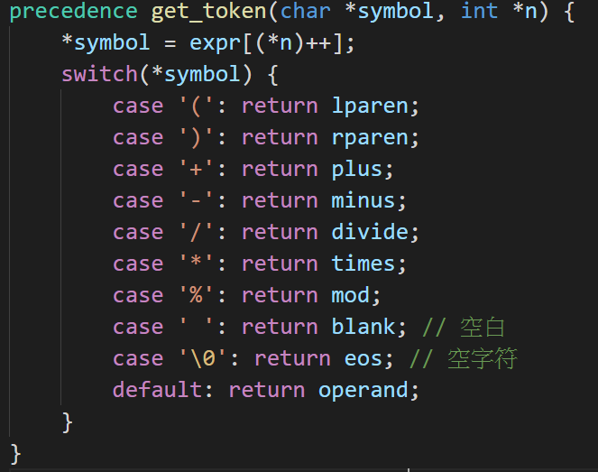
Infix to postfix
Notes:
P134 program 3.14
P132 有token to string的原因

Slide 58
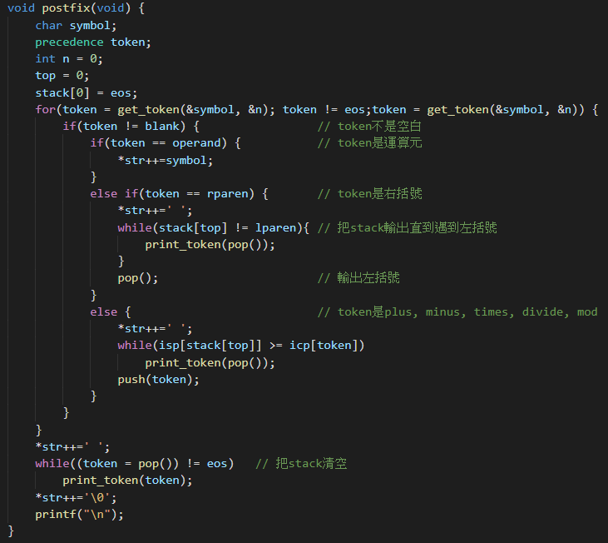
Infix to postfix
Notes:
P137 program 3.15

